Slide 1

Introduction to Computers and C++ Programming
Lecture 1

Slide 2
Description
In this chapter we will discuss about the main component of computer, bytes and addresses, computer system, programs, language, compiler and software development life cycle. In the c++ part we discuss about a brief introduction to c++, compiling and running the c++ program and testing and debuging

Slide 3
Main Components of a Computer
CPU
Main memory
00011111
10101100
11100011
Input device(s)
Output device(s)
Secondary memory

Slide 4
Bytes and Addresses
Main memory is divided into numbered locations called bytes.
The number associated with a byte is called its address.
A group of consecutive bytes is used as the location for a a data item, such as a number or letter. The address of the first byte in the group is used as the address of this larger memory location.

Slide 5
Computer Systems
Software
Operating System
PCs
Haedware
Workstations
Programs
Mainframes

Slide 6
What is a program?
A program is set of instructions for a computer to follow
Whenever we give a computer both a program to follow and some data for the program, we are said to be running the program on the data, and the computer is said to execute the program on the data.

Slide 7
Languages
High Level Languages
C++
Java
Low Level Languages
Assembly Language
Add X Y Z
Machine Language
00011101

Slide 8
Compilers
Programs that translate a high-level language like C++ to a machine-language that the computer can directly understand and execute.

Slide 9
Preparing a C++ program for Running
C++ program
Source Code
Compiler
Object code for other routines
Object code for C++ program
Linker

Slide 10
Program Design Process
Problem-solving phase
Implementation phase
Start
Translating
to C++
Problem
definition
Testing
Algorithm
design
Desktop
testing
Working
Program

Slide 11
The Software Development
Method
1. Specify the problem requirements.
2. Analyze the problem.
Input:
Output:
Formulas:
3. Design the algorithm to solve the problem.
4. Implement the algorithm.
5. Test and verify the completed program.
6. Maintain and update the program.

Slide 12
The Software Life Cycle
Analysis and specification of the task (problem definition)
Design of the software (algorithm design)
Implementation (coding)
Testing
Maintenance and evolution of the system
Obsolescense

Slide 13
Introduction to C++
BCPL
B programming language
C programming language
Dennis Ritchie
1970s
Bjarne Stroustrap
1980s
C++

Slide 14
Layout of a C++ Program
#include <iostream>
using namespace std;
int main()
{
Variable_Declarations
Statement_1
Statement_2
…
Statement_Last
return 0;
}
Program starts here
Program ends here

Slide 15
Layout of a C++ Program
#include <iostream>
using namespace std;
int main()
{
Variable_Declarations
Statement_1
Statement_2
…
Statement_Last
return 0;
}
include directive
standard namespace
main function
executable statements
return statement

Slide 16
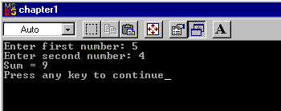
Sample C++ Program
#include <iostream>
using namespace std;
int main()
{
int number1, number2, sum;
cout << "Enter first number: ";
cin >> number1;
cout << "Enter second number: ";
cin >> number2;
sum = number1 + number2;
cout << "Sum = " << sum << “\n”;
return 0;
}

Slide 17
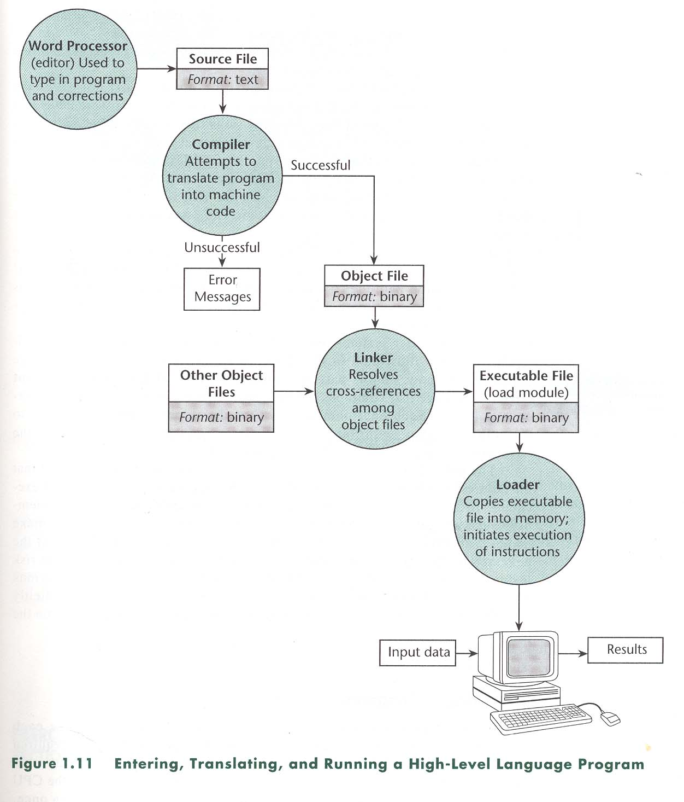
Compiling and Running a C++ Program

Slide 18
Testing and Debugging
Bug
A mistake/error in the program
Debugging
The process of eliminating bugs in a program

Slide 19
Testing and Debugging
Types of program errors:
Syntax errors
Violations of the rules of the programming language
Run-time errors
Detected by computers when the program is run (numeric calcualtions)
Logic errors
Mistakes in the underlying algorithm or translating the algorithm into C++ language

Slide 20
Sample C++ Program
Try this:
Write a program that displays the product of two integers
#include <iostream>
using namespace std;
int main()
{
int number1, number2, product;
cout << "Enter first number: ";
cin >> number1;
cout << "Enter second number: ";
cin >> number2;
product =…………………..?
cout << “Product = " << product << “\n”;
return 0;
}

Slide 21
Summary
Structure of Main Component of Computers
Understanding the bytes and addresses
Flow diagram of hardware and software
Introduction to c++ programming
What is program?
Languages and compilers
Testing and debbuging

Slide 22
Thank You

